Slide 1
INFORMED SEARCH:
AO* ALGORITHM

Slide 2
TYPES OF SEARCHING
State Space Search: Searching technique in which a single goal state or a set of goal states have to be found or identified.
Problem Reduction Search: Planning how best to solve a problem that can be recursively decomposed into subproblems in multiple ways
  AO* Search
  Game Trees

Slide 3
PROBLEM REDUCTION:
EXAMPLE OF MATRIX MULTIPLICATION
Given: A set of matrices A1, A2, ……, An
To find: A1 X A2 X ……X An
Method 1: ((A1XA2)XA3)XA4……
(not an example of problem reduction.)
Method 2: ([(A1A2)(A3A4)][(A5A6)(A7A8)])…
(A1XA2) (A3XA4)
Represents AND
A1A2A3A4

Slide 4
AO = AND-OR
An OR node represents a choice between possible decompositions
  Only one child has to be solved.
  Solving is done by choosing the minimum cost subtree.
An AND node represents a given decomposition in which
  All successors have to be solved.
  Solving is done by taking the sum of the costs of the subtrees.

Slide 5
AND-OR GRAPHS
An AND-OR node is a combination of one or more ORed children and one or more ANDed children. For example:
GOAL: Acquire TV set
GOAL: Borrow a TV set
GOAL: Earn some money
GOAL: Buy a TV set

Slide 6
AND-OR GRAPH SEARCH PROBLEM
Given: [G, s, T],
where
G= implicitly specified AND-OR graph
s = start node of the AND-OR graph
T = set of terminal nodes
h(n)= heuristic function estimating the cost of solving the sub-problem at n.
To find: A minimum cost solution tree.

Slide 7
AO* ALGORITHM
Initialize: Set G* = {s}, f(s) = h(s).
G* = marked subtree (or subgraph) rooted at the start node s. If s ∈ T, label s as SOLVED.
T = set of leaf or terminal subproblems which are unit level subproblems, which can not be decomposed further but which have to be solved directly.
Terminate: If s is SOLVED, then Terminate.
AND node is SOLVED when all children are SOLVED.
OR node is SOLVED when the best cost child is SOLVED.

Slide 8
AO* ALGORITHM
Select: Select a non-terminal leaf node n from the marked subtree.
Expand: Make explicit the children of n. (Generate or expand the children of n).
For each new child m:
Set f(m) = h(m)
If m is a terminal node, label m as SOLVED.
Cost-revision: Call cost-revise(n).
Loop: Go to step 2.

Slide 9
AO* ALGORITHM: Cost Revision
Procedure cost-revise(n)
Create Z={n}.
n=the node from where cost revision is to be started.
If Z={ }, return.
Select a node m from Z such that m has no descendants in Z (because we want to go bottom up, we select a node which has no descendants).

Slide 10
AO* ALGORITHM: Cost Revision
4.If m is an AND node with children r₁, r₂, ….., r_{k},
Set f(m) = Σ [ f(r_{i}) + C(m, r_{i})].
where, f(r_{i} ) = Cost of child node,
and, C(m, r_{i}) = Cost of edge.
Mark the edge to each child of m with a double line indicating it is SOLVED. If each child is labeled SOLVED, then label m as SOLVED.

Slide 11
AO* ALGORITHM: Cost Revision
If m is an OR node with children r₁, r₂,….., r_{k},
Set f(m) = min { f(r_{i}) + C(m, r_{i}) }
Mark the edge to the best child of m with a double line indicating it is SOLVED. If the marked child is labeled SOLVED, then label m as SOLVED.
6. If the cost or label of m has changed, then insert those parents of m into Z for which m is a marked child.

Slide 12
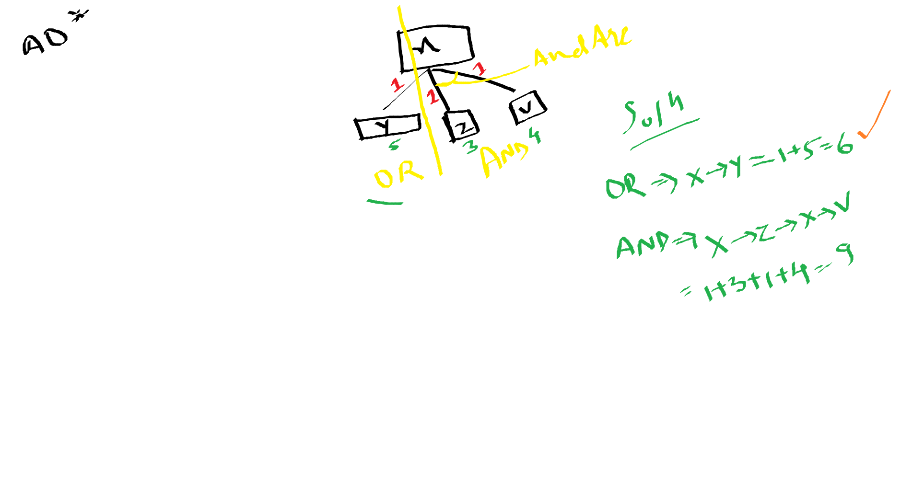

Slide 13
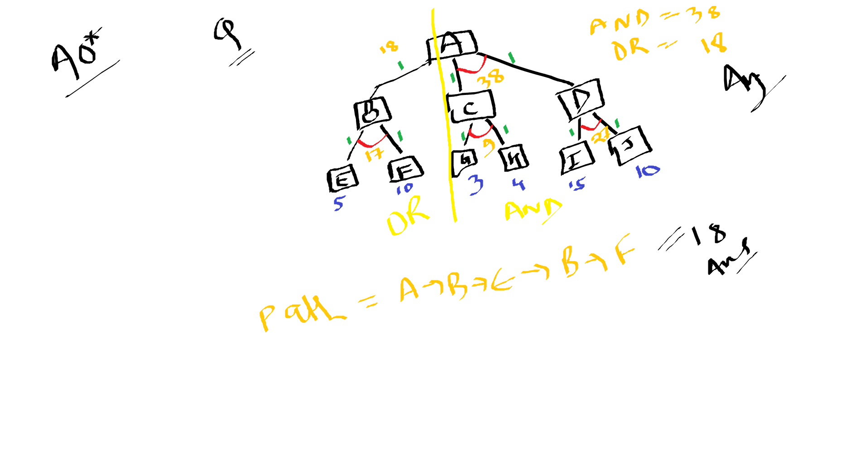

Slide 14
A
h=7
1.Initialize : G*={s}={A} & f(s)=h(s)=7
T={I, J, K, F, G} and A ∉ T, therefore, A is not SOLVED.
Select a non-terminal node, namely, A and expand it.

Slide 15
A
h=7
h=10
2
1
B
h=4
C
h=3
Z={A}. A has no descendants in Z, therefore, m=A. B and C are ANDed, therefore, f(A)=[f(B)+C(A, B)] + [f(C)+C(A, C)]=[4+2]+[3+1]=6+4=10.
Thus cost of A becomes 10. Mark B and C.
Go to step 2.
Expanding A, we get B and C with ANDing between them.
f(B)=h(B)=4 and f(C)=h(C)=3
Neither B nor C are terminal nodes, therefore they are not marked SOLVED.
Call cost-revise(A).

Slide 16
A
h=10
2
1
B
h=4
C
h=3
2
1
h=2
D
h=5
E
Z={B}. B has no descendants in Z, therefore, m=B. D and E are ORed, therefore, f(B)=min([f(D)+C(B, D)] , [f(E)+C(B, E)])
=min([2+2],[5+1])=min(4, 6)=4.
Thus cost of B remains 4. Mark D.
Go to step 2.
A is not SOLVED. Select B, a non-terminal node in the marked subtree and expand it to obtain D and E with ORing between them. f(D)=h(D)=2 and f(E)=h(E)=5.
Neither D nor E are terminal nodes, therefore they are not marked SOLVED.
Call cost-revise(B).

Slide 17
A
h=10
h=14
2
1
B
h=4
C
h=3
h=7
2
0
0
1
h=2
D
h=5
E
F
G
h=9
h=7
Z={ A}. A has no descendants in Z, therefore, m=A. B and C are ANDed, therefore, f(A)=[f(B)+C(A, B)] + [f(C)+C(A, C)]=[4+2]+[7+1]=6+8=14. Thus cost of A becomes 14.
Go to step 2.
Z={C}. C has no descendants in Z, therefore, m=C. F and G are ORed, therefore, f(C) =min([f(F)+C(C, F)] , [f(G)+C(C, G)])
=min([9+0],[7+0])=min(9, 7)=7. Thus cost of C becomes 7. Mark G.
Since C is a marked successor of A and the cost of C has changed, therefore insert A into Z, that is, now Z={A}.
Reiterate through cost-revise with n=A.
A is not SOLVED. Select C, a non-terminal node in the marked subtree and expand it to obtain F and G with ORing between them.
f(F)=h(F)=9 and f(G)=h(G)=7.
Both F and G are terminal nodes, therefore they are marked SOLVED.
Call cost-revise(C).

Slide 18
A
h=14
h=16
2
1
B
h=4
C
h=6
h=7
2
0
0
1
h=2
D
E
F
G
h=14
h=5
1
0
h=9
h=7
Reiterate through cost-revise with n=A.
Z={A}. A has no descendants in Z, therefore, m=A. B and C are ANDed, therefore,
f(A) =[f(B)+C(A, B)] + [f(C)+C(A, C)]
=[6+2]+[7+1]=8+8=16.
Thus cost of A becomes 16. Mark B and C.Go to step 2.
H
I
Z={B}. B has no descendants in Z, therefore, m=B. D and E are ORed, therefore,
f(B) =min([f(D)+C(B, D)] , [f(E)+C(B, E)])
=min([14+2],[5+1])=min(16, 6)=6.
Thus cost of B becomes 6. Unmark D and mark E. Since B is a marked successor of A and the cost of B has changed, therefore insert A into Z, that is, now Z={A}.
h=3
h=10
Z={D}. D has no descendants in Z, therefore, m=D. H and I are ANDed, therefore,
f(D) =[f(H)+C(D, H)] + [f(I)+C(D, I)]
=[3+1] + [10+0]=4+10=14.
Thus cost of D becomes 14. Mark H and I. Since D is a marked successor of A and the cost of D has changed, therefore insert B into Z, that is, now Z={B}.
Reiterate through cost-revise with n=B.
A is not SOLVED. Select D, a non-terminal node from the marked subtree and expand it to obtain H and I with ANDing between them.
f(H)=h(H)=3 and f(I)=h(I)=10.
H is a non-terminal node, whereas I is a terminal node, therefore I is marked SOLVED.
Call cost-revise(D).

Slide 19
A
h=16
h=18
2
1
B
h=6
C
h=8
h=7
2
0
0
1
h=14
D
h=5
E
F
G
h=7
1
0
0
0
h=9
h=7
H
I
J
K
h=3
h=10
h=3
h=4
A is not SOLVED. Select E, a non-terminal node from the marked subtree and expand it to obtain J and K with ANDing between them. f(J)=h(J)=3 and f(K)=h(K)=4.
Both J and K are terminal nodes, therefore both are marked SOLVED.
Call cost-revise(E).

Slide 20
Since, F, G, I, J, K are now all labelled SOLVED, therefore, a is SOLVED and we terminate the algorithm. Thus, the minimum cost of solving the problem A has been found to be 18. The problem can be solved at minimum cost by solving the subproblems B and C, each having further marked subproblems of [E, J, K] and [G], respectively. This is shown by the marked subtree of the AND-OR tree.
Reiterate through cost-revise with n=A.
Z={A}. A has no descendants in Z, therefore, m=A. B and C are ANDed, therefore,
f(A) =[f(B)+C(A, B)] + [f(C)+C(A, C)]
=[8+2]+[7+1]=10+8=18. Thus cost of A becomes 18.
Go to step 2.
Z={B}. B has no descendants in Z, therefore, m=B. D and E are ORed, therefore,
f(B) =min([f(D)+C(B, D)] , [f(E)+C(B, E)])
=min([14+2],[7+1])=min(16, 8)=8. Thus cost of B becomes 8.
Since B is a marked successor of A and the cost of B has changed, therefore insert A into Z, that is, now Z={A}.
Z={E}. E has no descendants in Z, therefore, m=E. J and K are ANDed, therefore,
f(E) =[f(J)+C(E, J)] + [f(K)+C(E, K)]
=[3+0] + [4+0]=3+4=7. Thus cost of E becomes 7. Mark J and K.
Since E is a marked successor of B and the cost of E has changed, therefore insert B into Z, that is, now Z={B}.Reiterate through cost-revise with n=B.

